Slide 1


Hand-Signs Object Detection Classification
Tan Jun-Yen
2021

Slide 2

Who Am I?
Education
Bachelor of Science in Quantity Surveying
(Hons)
Heriot-Watt University
Industry Certified Data Science and Artificial Intelligence
Institute of Data
Professional Experience
1 year of experience in Quantity Surveying and 6 months experience in e-Commerce where my passion to solve business problems developed.

Slide 3

Agenda
Project Context
Industry, Domain, Area of Interests
Business Aspects, Data science Aspects
Problem Definiton
Data Process Design
Overall Workflow, Exploratory Data Analysis, Feature Engineering
Modelling, Evaluation,
Hyperparameter and Performance Tuning
Values Delivery
Next Steps and Summary
Summary, Next Steps, Deployment

Slide 4
Project Context
01
Industry, Domain, Area of Interest

Slide 5
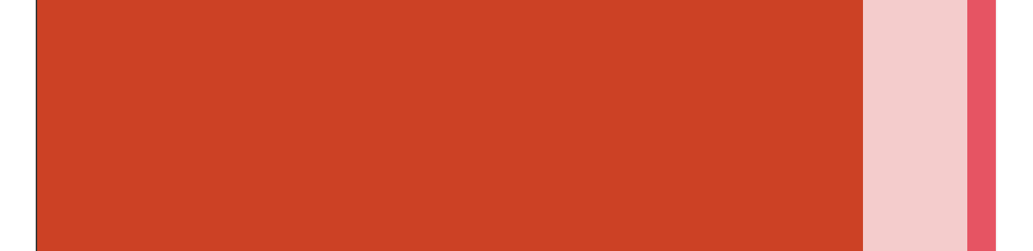
Industry
Population with hearing impairment
3.6%
Population with impairment
100%
12.6%
Total US population

Slide 6
Domain
Face Detection
Dogs vs Cats
Security (Apple)
Beginner Classification
Object Detection
Self-Driving Cars (Tesla)
Competition (Google Research)
Pedestrian Detection
Open Images 2019

Slide 7
Area of Interest
The ability of a computer to interpret daily object as accurately as humans if not more, but completely different ways to identify those objects.

Slide 8
Problem Definition
02
Business Aspects, Data Science Aspects

Slide 9
Business Question
Data Question
01
03
Business Value
Data Required
02
04
World Federation of Deaf (WFD) aim to translate sign language for the population who does not understand sign language
How accurately can we predict hand signs and translate into common spoken languages?
Aims to push translation onto Google’s Google Translate Platform as it currently supports 109 languages at various levels where none are Hand-Signs Language, has 500 million total users, with more than 100 billion words translated daily.
Images of Hand-Signs are required in the study to detect and classify Hand-Signs

Slide 10
Data Process Design
03
Overall Workflow, Exploratory Data Analysis, Feature Engineering

Slide 11
Overall Workflow
Understanding the Data
Convolutional Neural Network
Exploratory Data Analysis
Modelling
Problem Definition
Feature Engineering
Evaluation
Business Question and Data Question
Resize, Grayscale, Normalize
Validation Testing

Slide 12
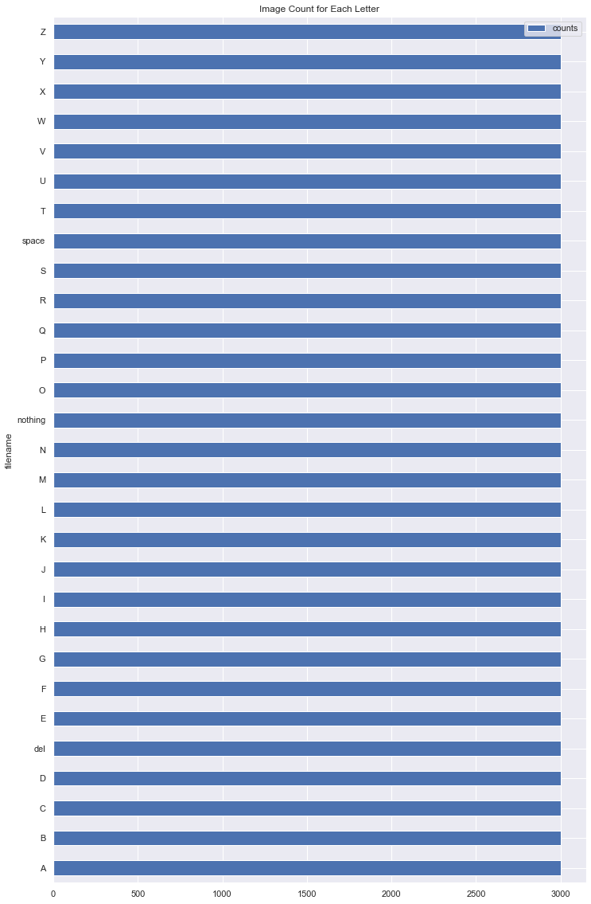
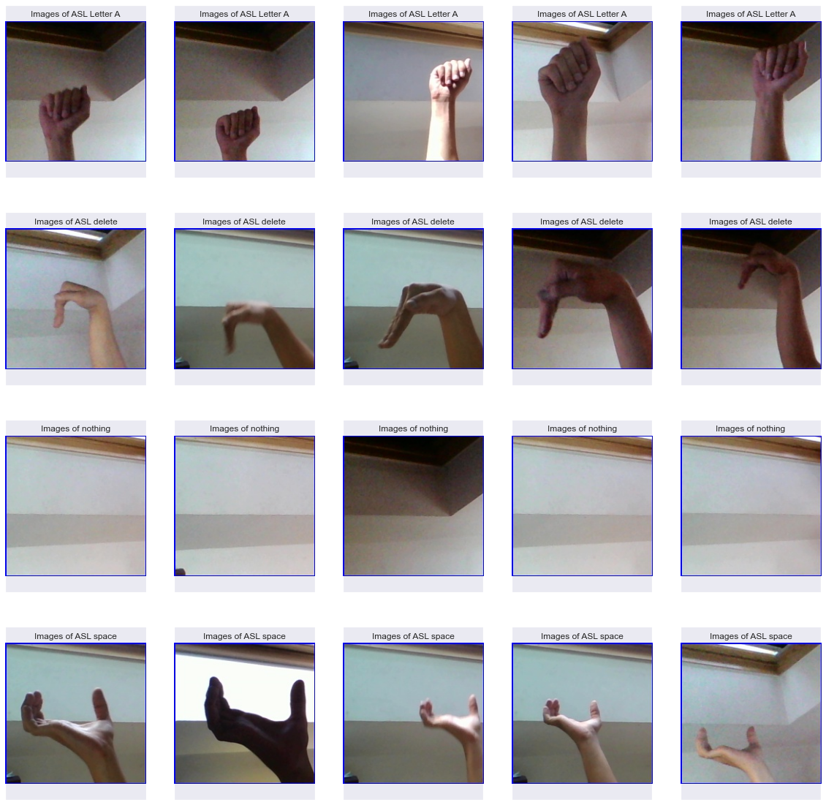
Data Sourced
Due to time and computational power limitations, ASL alphabets will be the data used in this study.

Slide 13
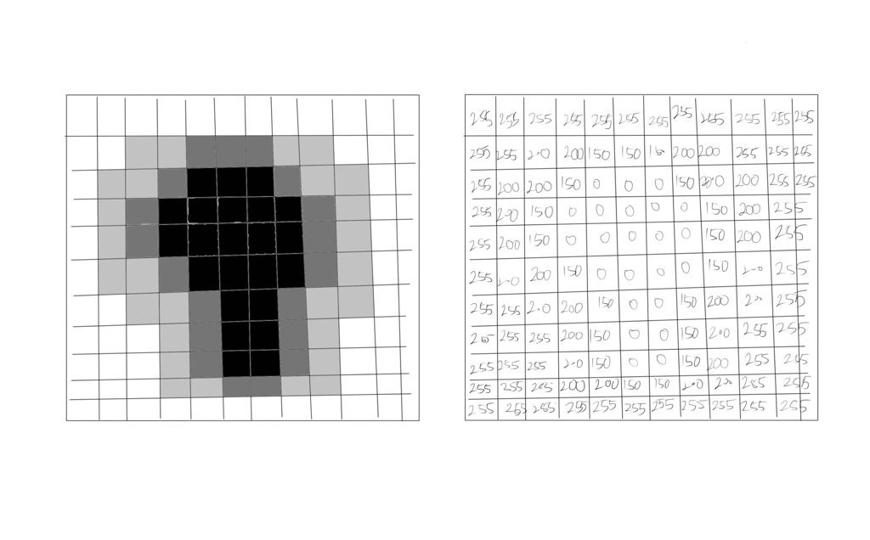
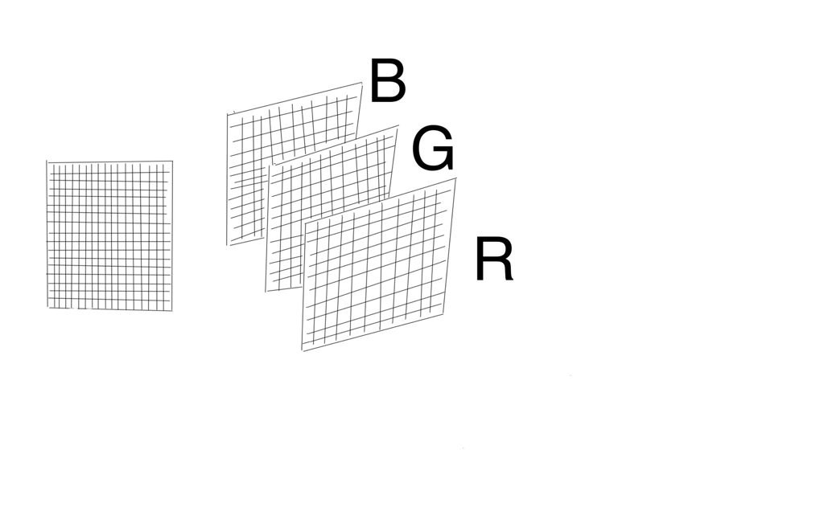
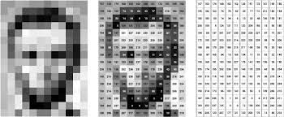
Understanding How Computers Look at Images

Slide 14
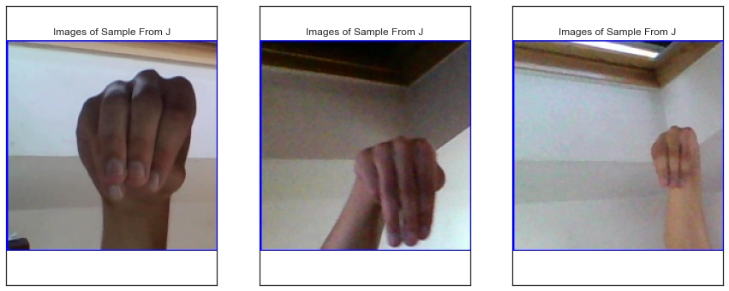
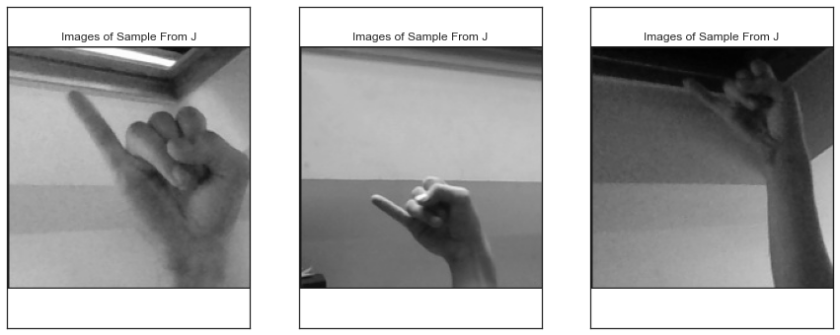
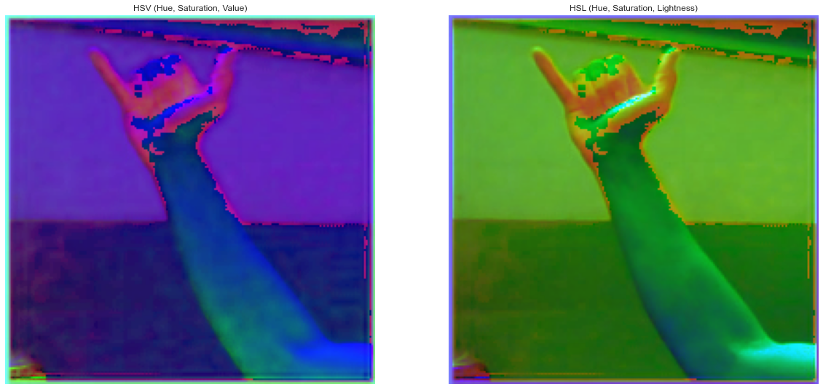
RGB, Grayscale, HSV and HLS Channels
HSV (Hue, Saturation, Value)
HSL (Hue, Saturation, Lightness)
RGB (Red, Green, Blue)
Grayscale

Slide 15
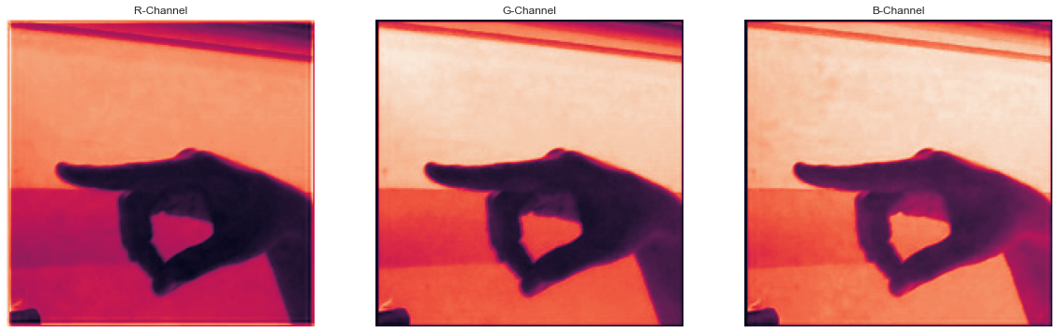
RGB Channel
Red
Green
Blue

Slide 16
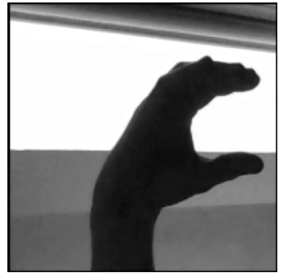
Grayscale Channel

Slide 17
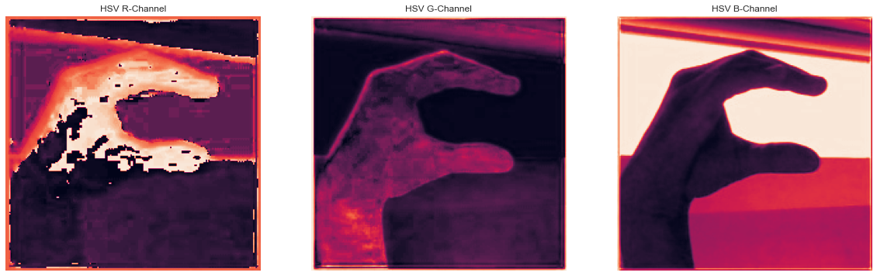
HSV Channel
Hue
Saturation
Value

Slide 18
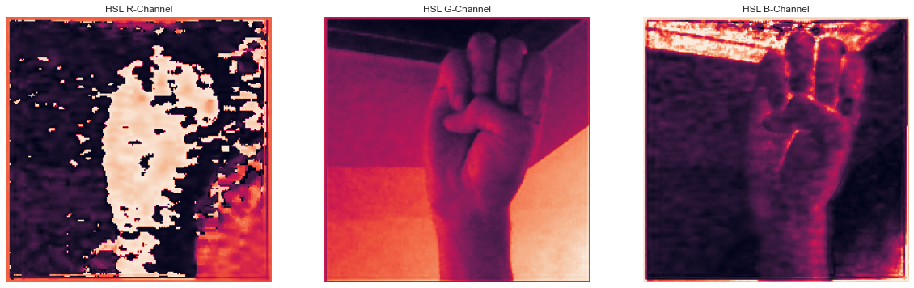
HSL Channel
Hue
Lightness
Saturation

Slide 19
Feature Engineering
Resize | Convert Color | Datatype | Normalize
Resized image to 128x128 from 200x200 | Convert image into Grayscale Image | Convert Pixel Value in array to float type | Change value range from 0 – 255 to 0 - 1

Slide 20
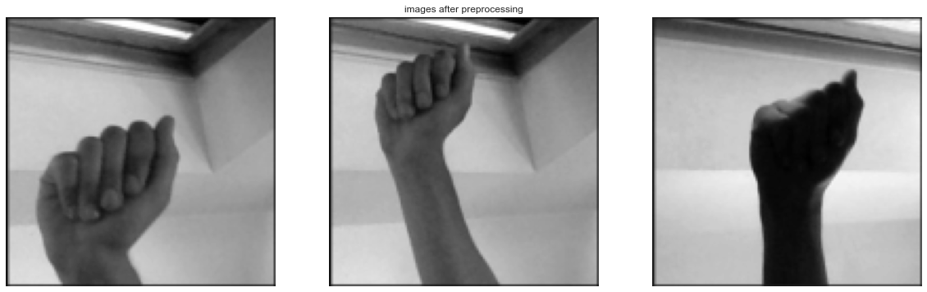
Example of Images After Feature Engineering

Slide 21
Values Delivery
04
Modelling, Evaluation, Hyperparameter and Performance Tuning

Slide 22
Convolutional Neural Network
Input
Hidden Layer(s)
Output
Convolutional Layers
Dense, Dropout, Flatten
Feature Extraction
Training
Output

Slide 23
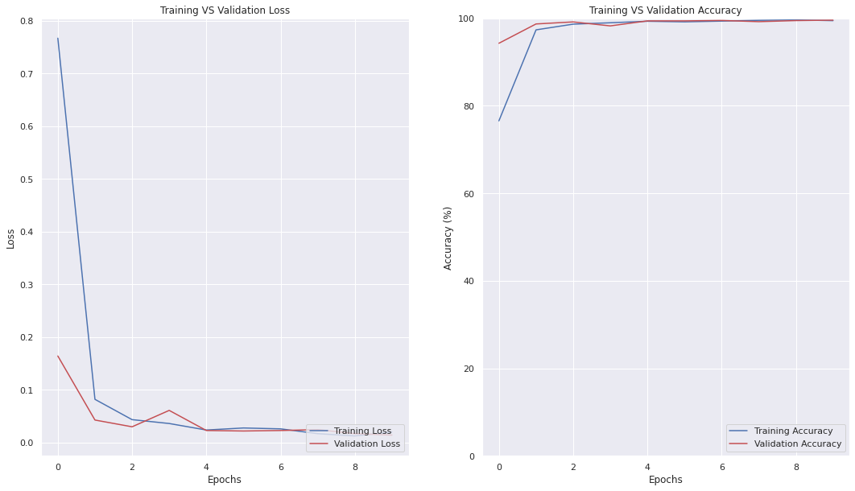
Model’s Performance

Slide 24
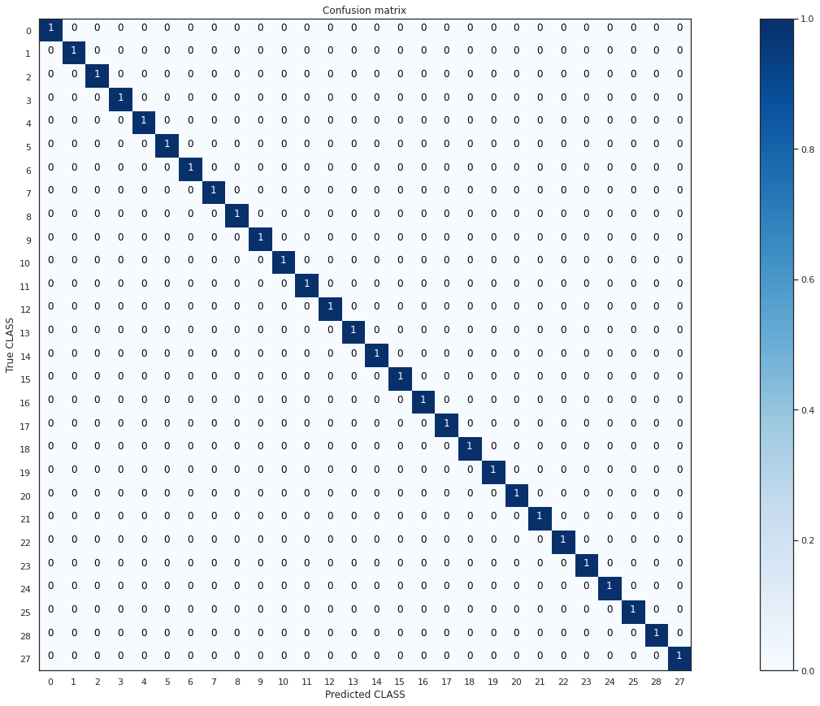
Evaluation with Test Data

Slide 25
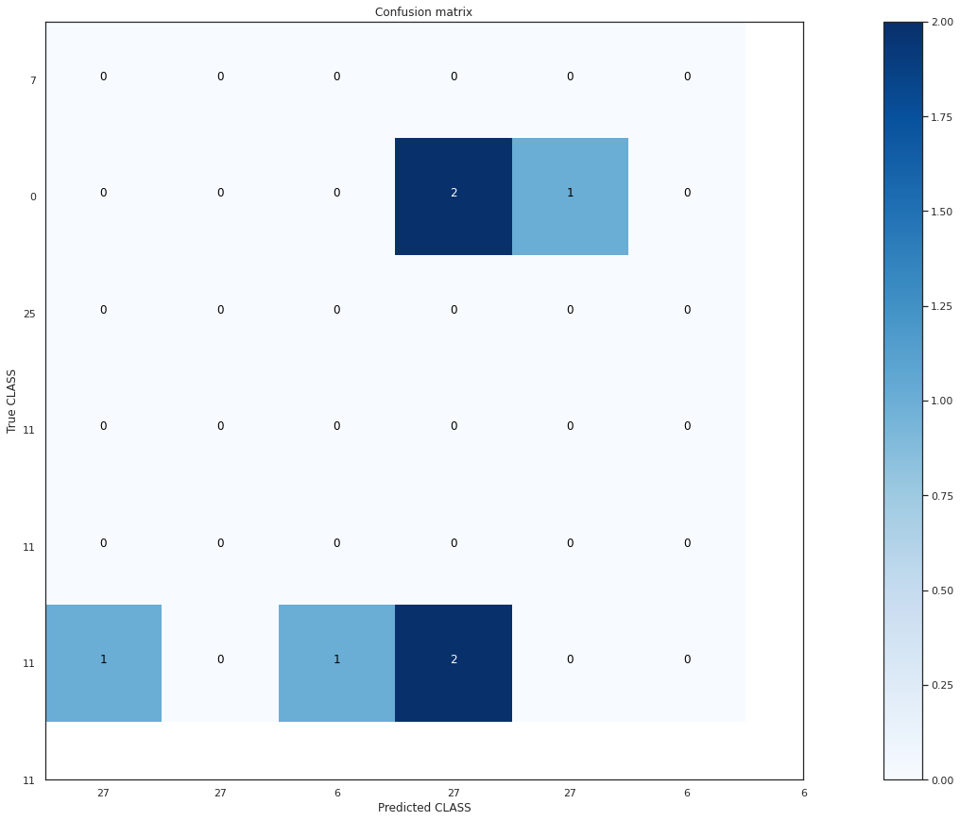
Further Evaluation with Random Images

Slide 26
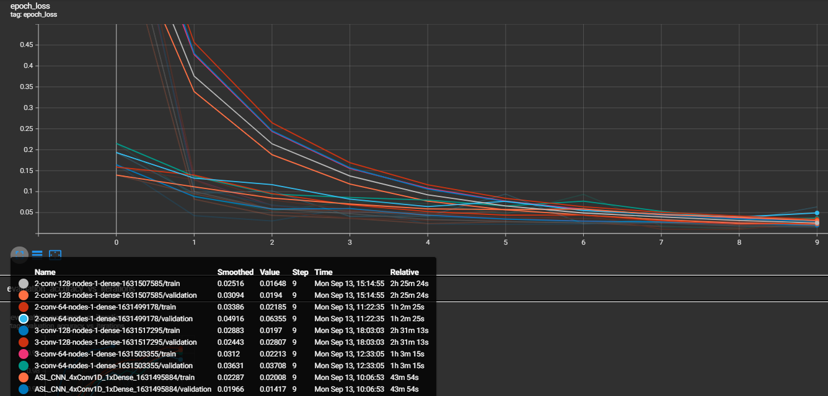
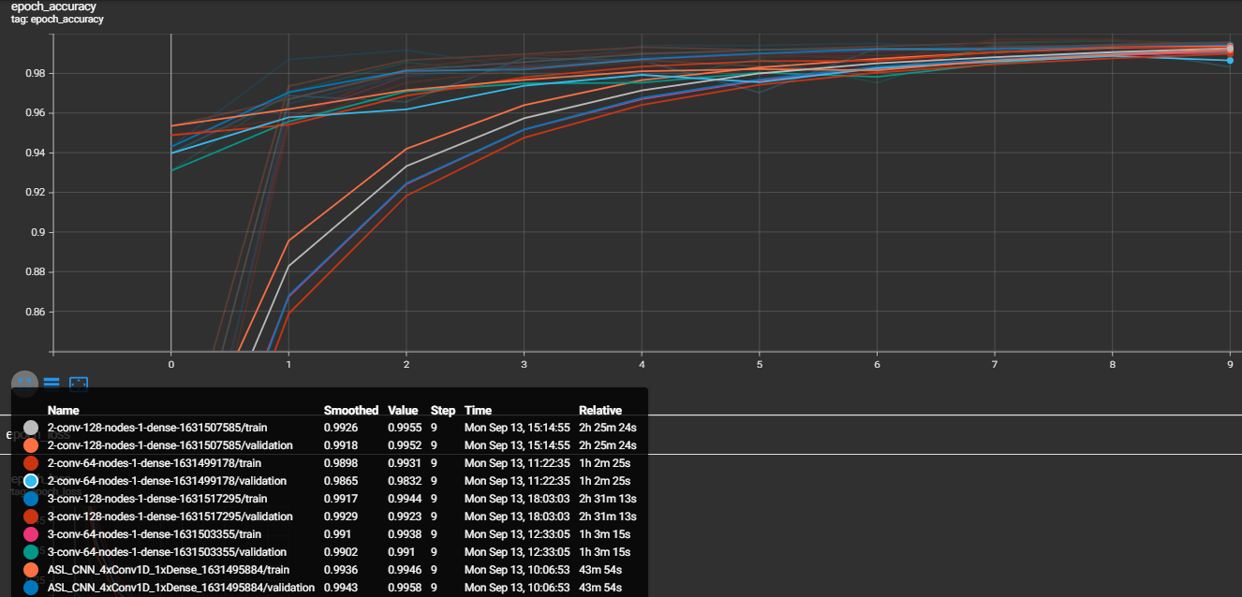
Hyperparameter Tuning

Slide 27
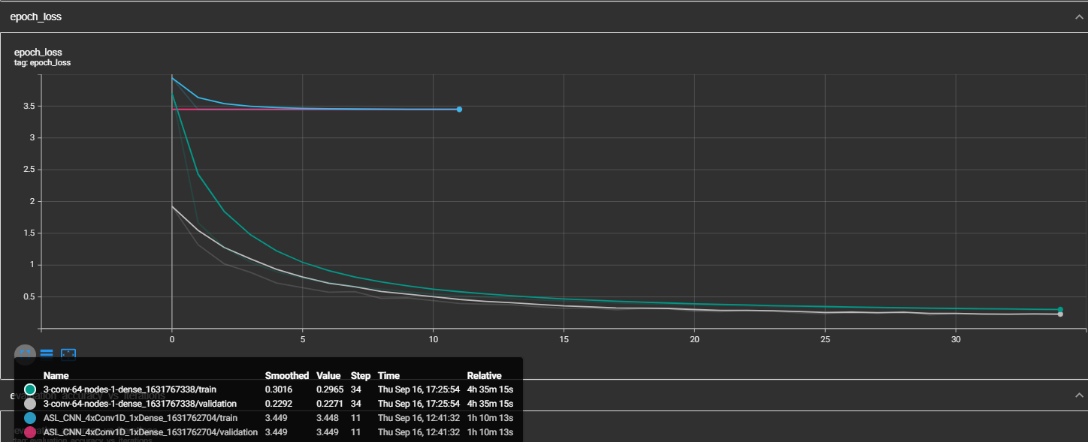
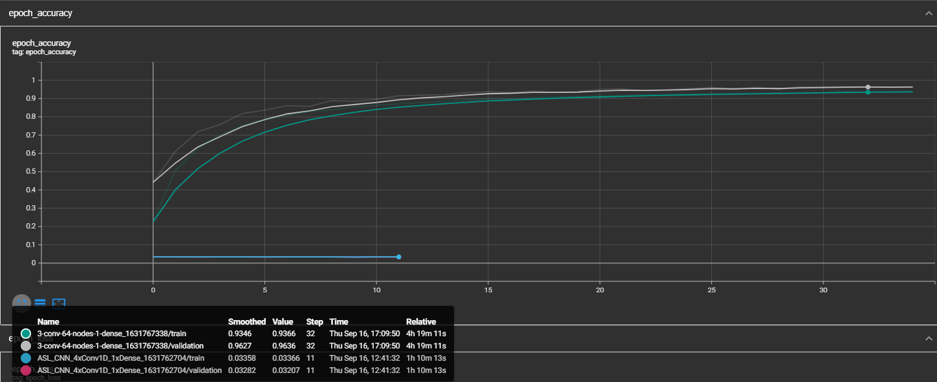
Performance Tuning

Slide 28
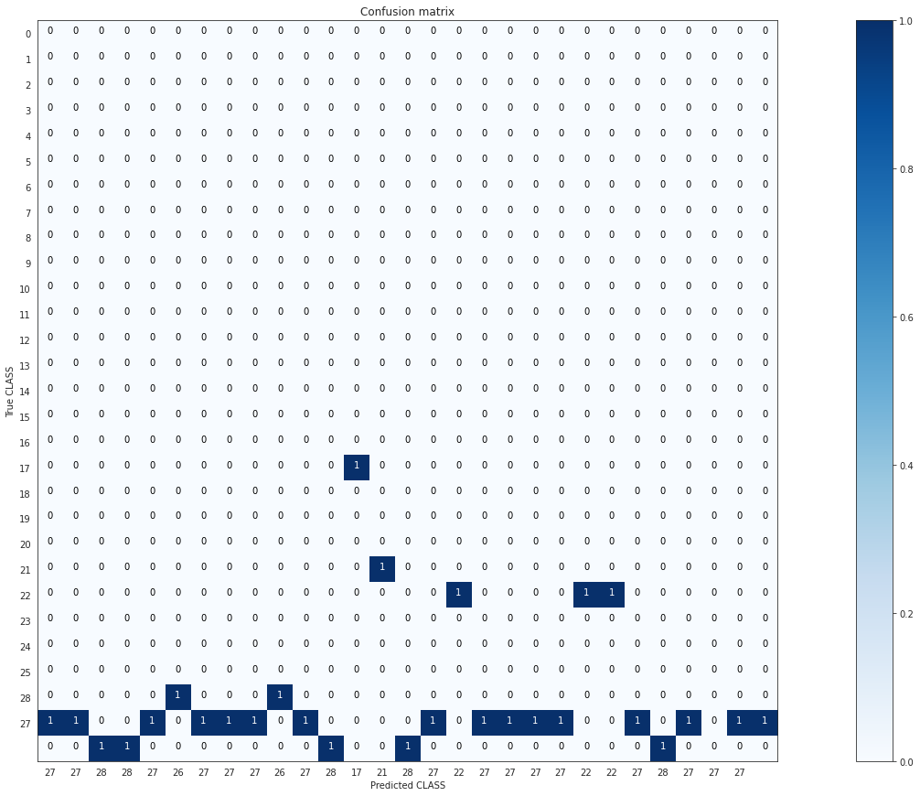
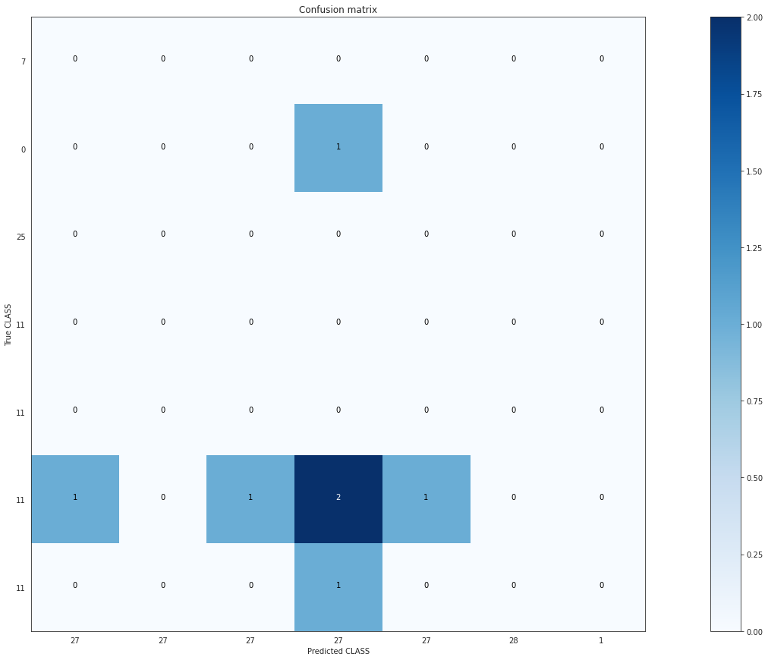
Performance Tuning Evaluation

Slide 29
Next Steps and Summary
05
Summary, Next Steps, Deployment

Slide 30
Next Steps
Pre-Trained Models
Tensorflow Model Zoo has a list of pre-trained TensorFlow models applicable to Object Detection
Data Source
A new set of data is recommended to prevent overfitting of training data to our model
Transfer Learning
With the use of Pre-Trained Models, machine learning method of Transfer Learning, we can speed up training and improve performance of model.

Slide 31
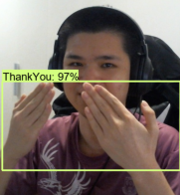
DEPLOYMENT
Detecting…
With the Utilization of Google Translate, users are able to translate Hand-Signs from video capture to overcome communication barrier between deaf community and the population
Translation:
Thank You

Slide 32
Summary
Limited Variation in Data Sourced
Combat Overfitting
Combat Overfitting
Combat Overfitting
Time and Computation Power Limitations
Next Steps
Tuned the Number of layers and Number of Nodes in Each Layer
Use OpenCV to Capture Images, Able to Control the Variation of Images
Introduced Dropout, Kernel Regularizers
Utilized Image Augmentation, Increases Number of Images in DataSets and Variation of Images
Settled on Low Epochs Which Proved to Reduce Model’s Performance
Utilize Pre-Trained Models, Introduce Transfer Learning, and Deploy Model for Client’s Understanding on Feasibility of Modelling

Slide 33

Thank You to Amin, Vincent and My Fellow Coursemates for Guiding and Helping Me Throughout the Program.

